Slide 1

Credit-Card-Approval
RNS INSTITUTE OF TECHNOLOGY
BENGALURU - 98
DEPARTMENT OF INFORMATION SCIENCE & ENGINEERING
Presentation on Internship
Arnav Kumar
USN: 1RN18IS026
New Age Solutions Technologies
Internal Guide
Dr. Prakash S
Professor , Dept of ISE, RNSIT
External Guide
Mr. Aman Upadhyay
NASTECH

Slide 2
AGENDA
Abstract
About the Company
Introduction
Literature Survey
Requirements
System Design
Detailed Design
Implementation
Testing
Conclusion and Future Enhancements
References
Q & A
VIII Semester, Department of ISE, RNSIT
2021 - 2022

Slide 3
ABSTRACT
With the advancement of web technology and its growth, there is a huge volume of data present on the web for internet users and a lot of data is generated too.
Profit to the credit card providers largely depend on if person is paying back.By predicting correct credit card customers ,the banks can maximise the profits
In the banking system, there is a major task to determine if the person is eligible for the credit card
We here try to automate this process by applying machine learning techniques. Here we need to make sure to target the right customers.
VIII Semester, Department of ISE, RNSIT
2021 - 2022

Slide 4
About the Company
NASTECH is one of the leading Global Certification and Training service providers for technical and management programs for educational institutions.
They collaborate with educational institutes to understand their requirements and form a strategy in consultation with all stakeholders to fulfill those by skilling, reskilling, and upskilling the students and faculties on new-age skills and technologies.
Their LMS solutions provide a centralized source of information and education that will cater to all the needs of educational institutions.
VIII Semester, Department of ISE, RNSIT
2021 - 2022

Slide 5
INTRODUCTION
The recent years has seen huge growth in credit cards and loans.
The correct assessment for credit card approval is very important for banks and organisations who lend credit card to the people.
The exact judgement of person to be approved for credit cards allows the organisations to minimise losses and same time make suitable credit arrangements as per requirement.
Due to huge growth in number of applicants there is need for more sophisticated method to automate the process and speed it up.
VIII Semester, Department of ISE, RNSIT
2021 - 2022

Slide 6
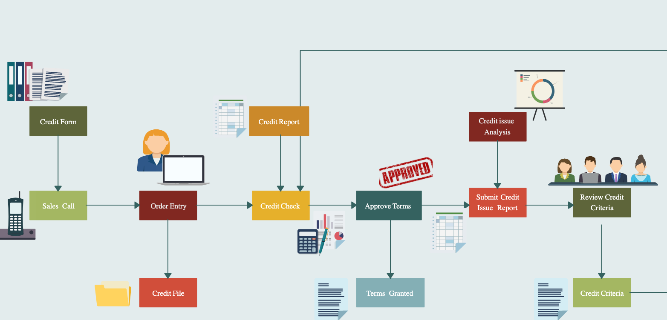
LITERATURE SURVEY
Commercial banks receive a lot of applications for credit cards. Many of them get rejected for many reasons, like high loan balances, low income levels, or too many inquiries on an individual’s credit report
Techniques that were used previously parametric and non-parametric models, models like logistic regression and LDALogistic regression overcomes these problems later turn out to be common credit scoring .
VIII Semester, Department of ISE, RNSIT
2021 - 2022

Slide 7
The prediction is taken into consideration after applying sigmoid function into it.
Non parametric techniques are k-nearest neighbours, decision tree, support vector machines.
SVM can be combined with back propagation neural network to get better accuracy The results displayed SVM’s accuracy comparable to that of back propagation neural network. Further there have been improvement in various other hybrid data mining techniques to get better results at these kinds of problems.
Various ensemble method have also been to used to get improved accuracy by aggregating scores.
Credit card approval is also being done through genetic programming, this paper examines the usage of strong typed genetic programming for automated credit approval
VIII Semester, Department of ISE, RNSIT
2021 - 2022

Slide 8
Eight different genetic programming approaches where applied and compared.
In another paper implementation based on logistic regression has been compared with XGBoost algorithm.
It is found that XGBoost 096 algorithm has significantly higher model discrim- ination and model stability than that of logistic regression.
VIII Semester, Department of ISE, RNSIT
2021 - 2022

Slide 9
Requirements
Hardware Requirements
Software requirements & other requirements
Operating system: Windows 7/8/10/11 or Linux
Twitter dataset
Modern web browser with internet access
Python 3
Processor: Intel i5 or more
RAM: 8 GB or more
Cache: 512 KB
Hard disk: 16 GB
Monitor : 1024 x 720 display
Speed: 2.7GHZ or more
VIII Semester, Department of ISE, RNSIT
2021 - 2022

Slide 10
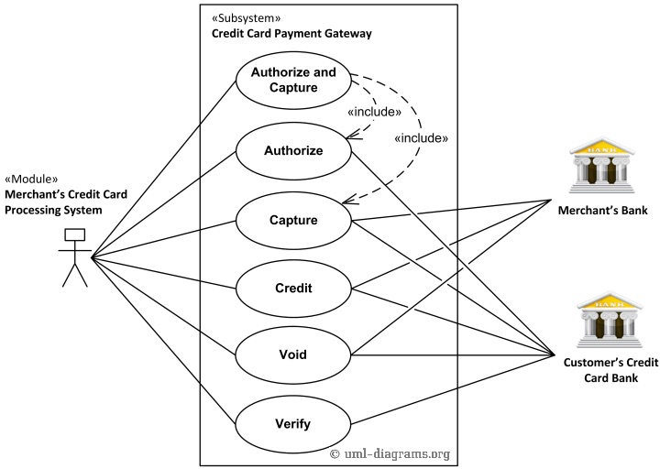
System Design
Overview of the system
VIII Semester, Department of ISE, RNSIT
2021 - 2022

Slide 11
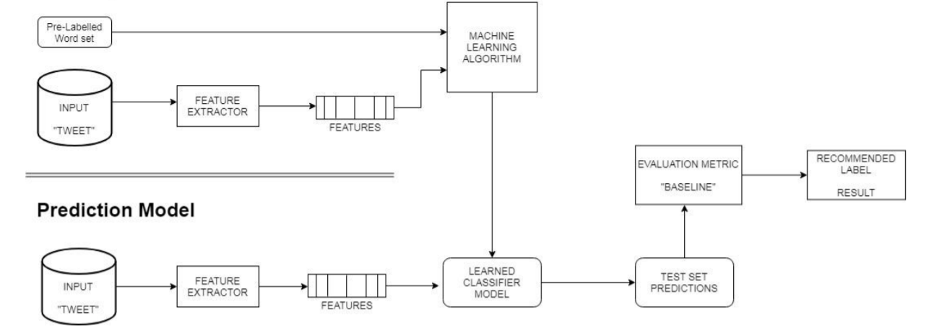
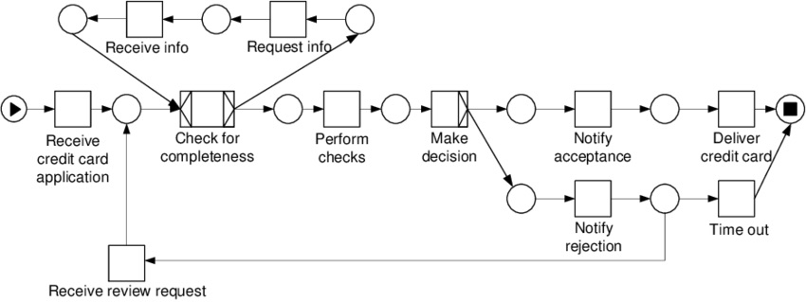
Detailed Design
Detailed design of the system
VIII Semester, Department of ISE, RNSIT
2021 - 2022

Slide 12
Implementation / Coding
Project structure
Import libraries and datasets
Perform exploratory data analysis
Data Distribution and Description
Count plot using SEABORN
Perform data cleaning
Testing
VIII Semester, Department of ISE, RNSIT
2021 - 2022

Slide 13
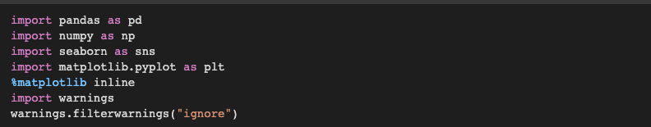
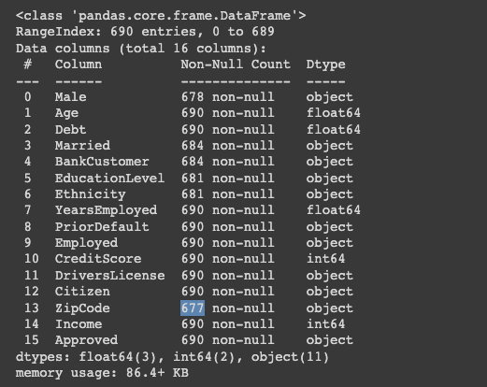
Import libraries and datasets
Exploratory data analysis
VIII Semester, Department of ISE, RNSIT
2021 - 2022

Slide 14
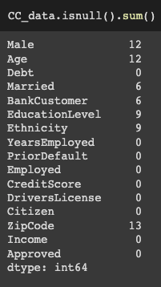
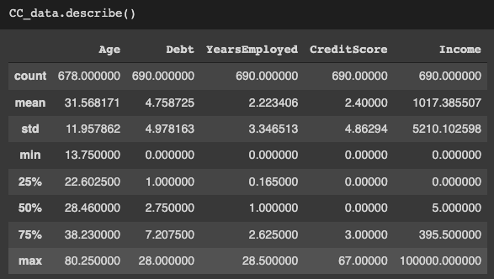
VIII Semester, Department of ISE, RNSIT
2021 - 2022

Slide 15
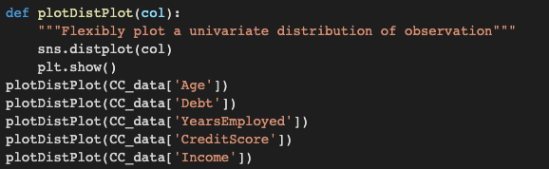
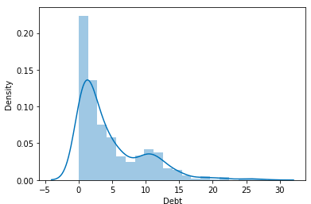
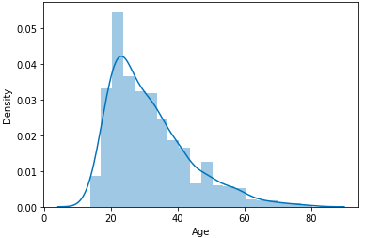
Data description and distribution

Slide 16
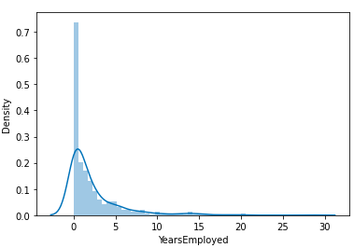
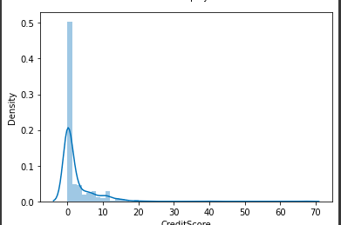

Slide 17
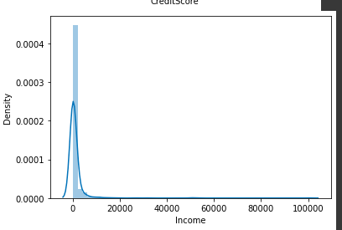

Slide 18
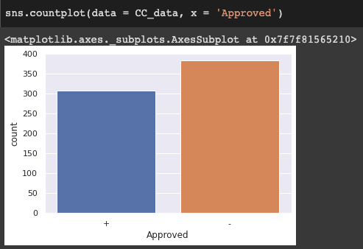
Count plot using seaborn library
VIII Semester, Department of ISE, RNSIT
2021 - 2022

Slide 19
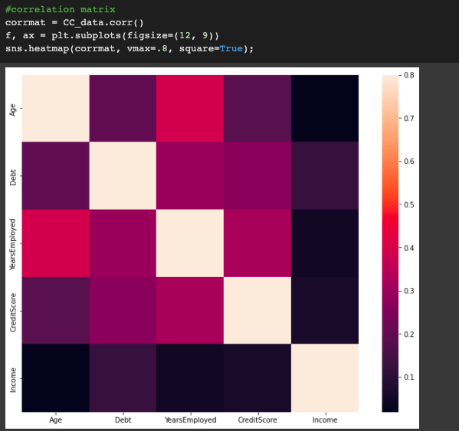
Correaltional Matrix

Slide 20
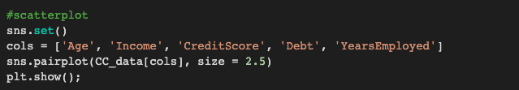
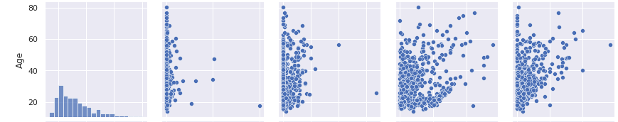
Use of Scatterplot

Slide 21
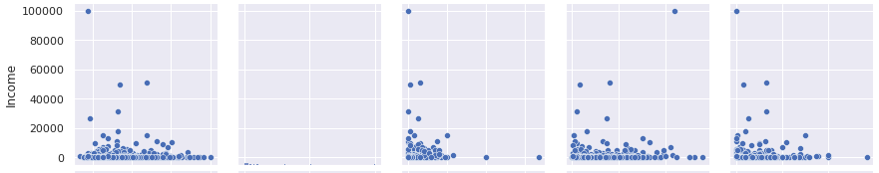
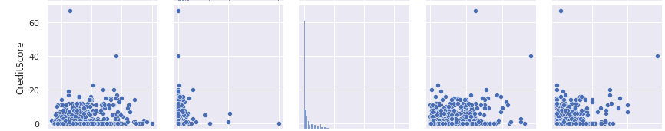

Slide 22
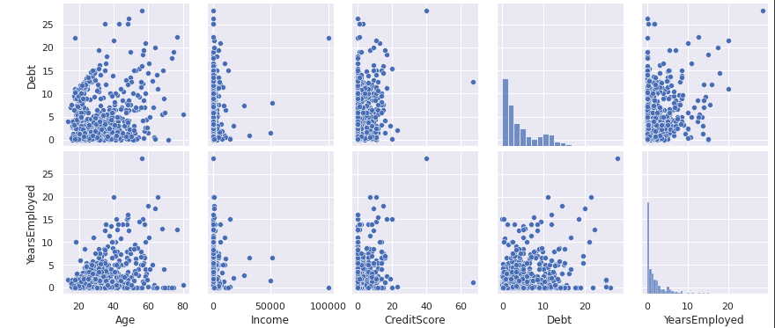

Slide 23
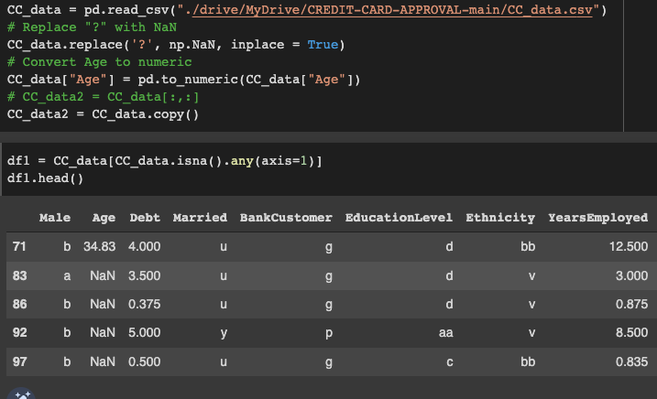
Perform data cleaning
Remove ? With NaN from csv file
VIII Semester, Department of ISE, RNSIT
2021 - 2022

Slide 24
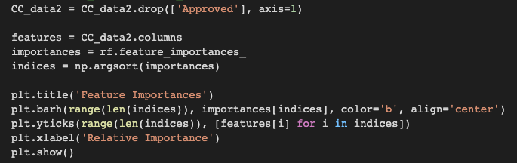
Attribute with most importance for selecting credit card

Slide 25
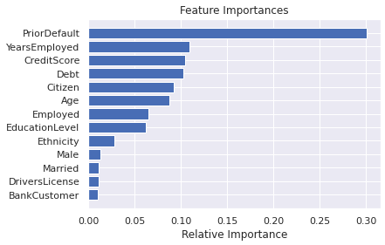

Slide 26
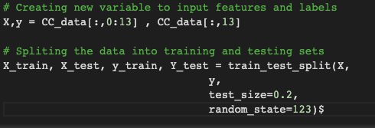
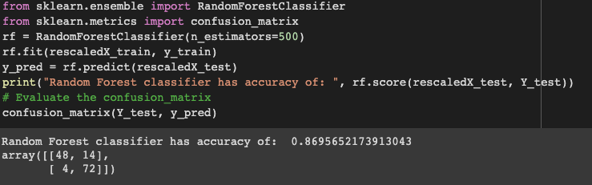
Testing
VIII Semester, Department of ISE, RNSIT
2021 - 2022

Slide 27
CONCLUSIONS
As our country developing so it will surely increase the credit card holders, issueing more credit card will also boost the countries economy.
But issuing credit card requires a lot of human time, by developing Credit Card Approval System
we are helping the bank sector and saving them from bankrupting
by predicting whom to issue credit card whom to not .
VIII Semester, Department of ISE, RNSIT
2021 - 2022

Slide 28
Future Enhancements
Future Enhancement can be done for Sentiment analysis for Dravidian Languages
Many analysers don’t perform well when the number of classes is increased. Also, it’s still not tested that how accurate the model will be for topics other than the one in consideration.
Machine Learning algorithm’s accuracy to be increased.
Database is limited for processing structured data and has a limitation when dealing with a large amount of data.
VIII Semester, Department of ISE, RNSIT
2021 - 2022

Slide 29
REFERENCES
[1] https://www.kaggle.com for Twitter sentiment dataset
[2] https://ieeexplore.ieee.org/document/7877424
[3] https://ieeexplore.ieee.org/document/9537243
[4] https://ieeexplore.ieee.org/document/8474783
[5] https://ieeexplore.ieee.org/document/7912034
[6] https://ieeexplore.ieee.org/document/8252118
[7] https://ieeexplore.ieee.org/document/8515844
VIII Semester, Department of ISE, RNSIT
2021 - 2022

Slide 30
THANK YOU
VIII Semester, Department of ISE, RNSIT
2021 - 2022

